Slide 1


E-Learning Web Application: Alphazone
MINI PROJECT I
Aman Kushwaha
Section : 3A
University Roll Number : 181500075
Training Completion: Internshala and Coursera
A new way to engage with students and teacher from across the globe.

Slide 2
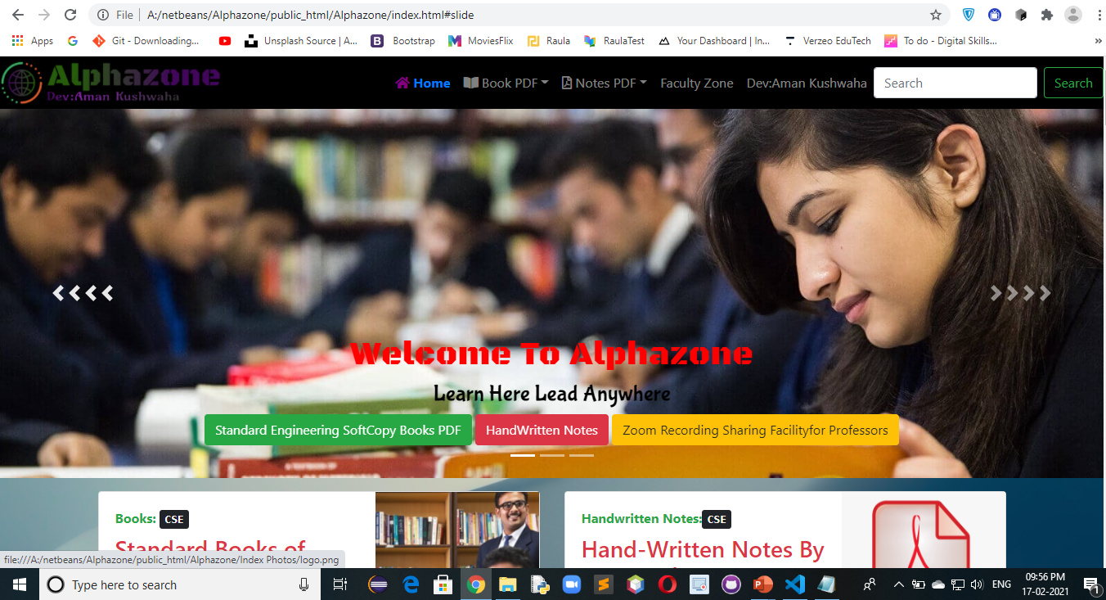
Introduction
This website is developed for B.Tech Computer Science students in order to provide best educational hand written notes ,standard notes and video lecture series.
Target millions of potential users to use and engage with our app.
No need of signup/signin to our app to post/share/like the links/urls .
No Need to pay Huge amount of money.

Slide 3
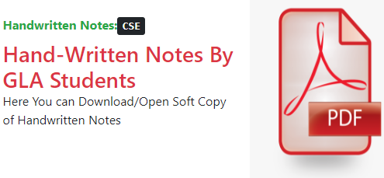

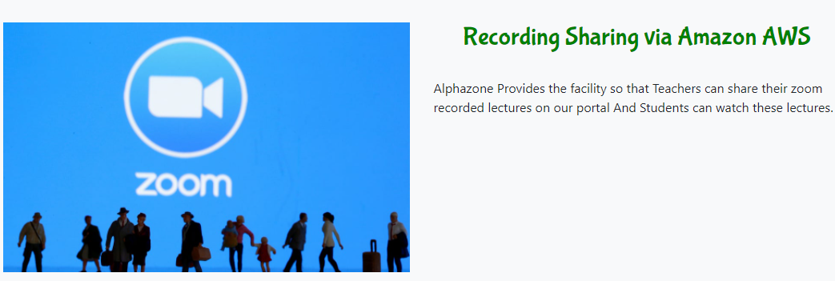
PROBLEM STATEMENT AND SOLUTION
Free Notes
All Standard Books
Faculty Section
No Need to pay Huge amount of money.
Always get latest versions of Books.
Teachers can share Zoom recording Links

Slide 4
Front End and Back End Framework:
This Website have 22 Front End Web Pages ,And 9 BackEnd Web Pages.
HTML 5 and CSS 3
BOOTSRAP 4 and JS
MERN
Major Portion of this Web Application covered through html 5.
HTML 5 Used- 45%
For Media Query And Website Responiveness I have used CSS 3.
CSS 3 Used – 30%
For Effects and Premade library of css classes this website uses Bootstrap and css.
Bootstrap and css used -35%
MongoDB
Express
React
Node

Slide 5
Hardware And Software Requirement
Software Requirement
Hardware Requirement
Windows 8.1 OS and above
Visual Studio Code
Web Browser
Github Desktop
Laptop/Desktop
​1.8 GHz or faster processor. Quad-core or better recommended
​ 4 GB of RAM and core i3 processor
​Hard disk space: Minimum of 500MB

Slide 6
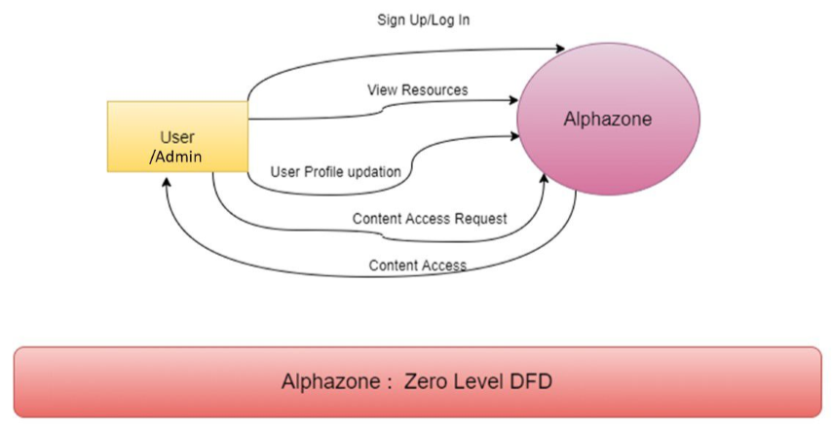
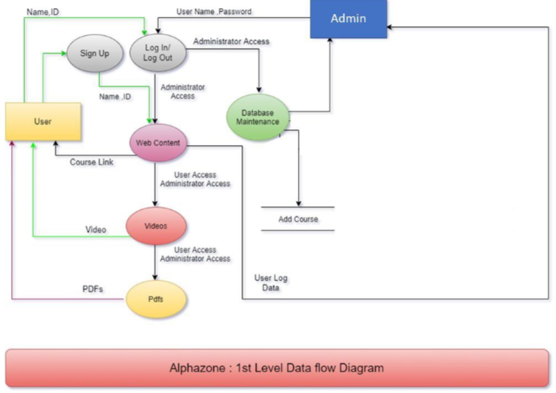
DFD Level Zero + Level One

Slide 7
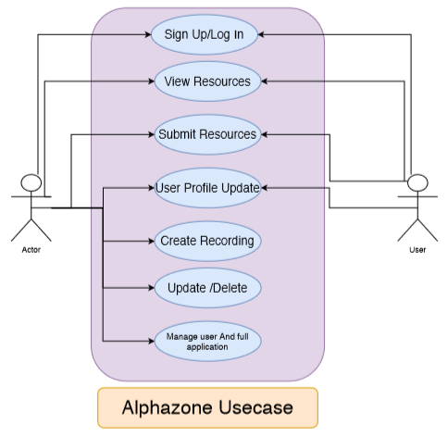
Usecase Diagram

Slide 8
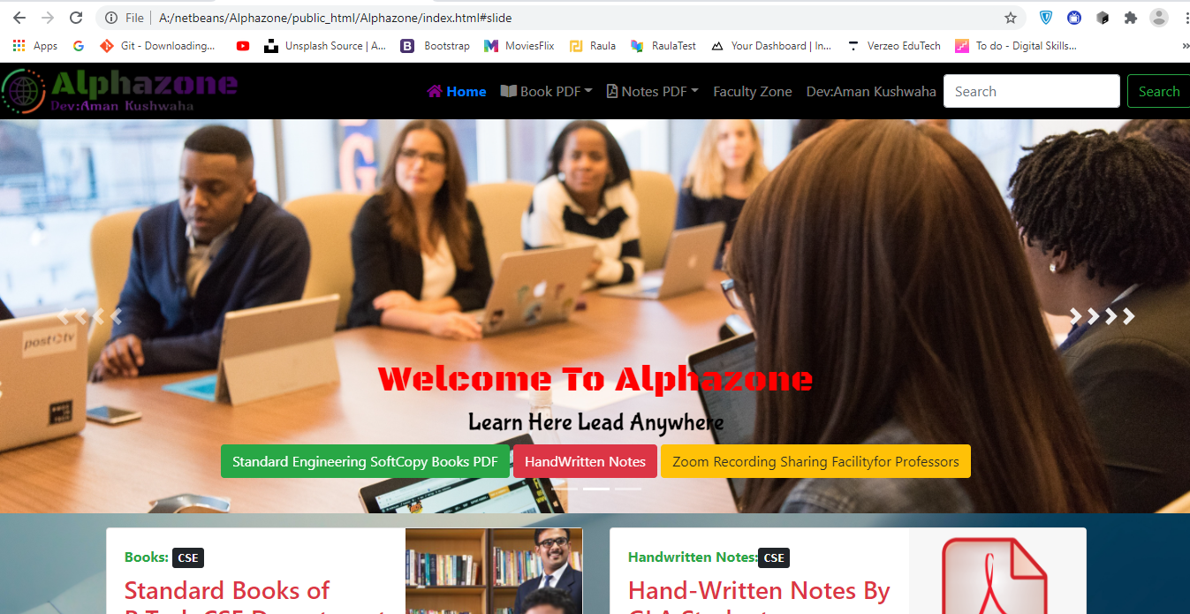
Section Divider
Home Page

Slide 9
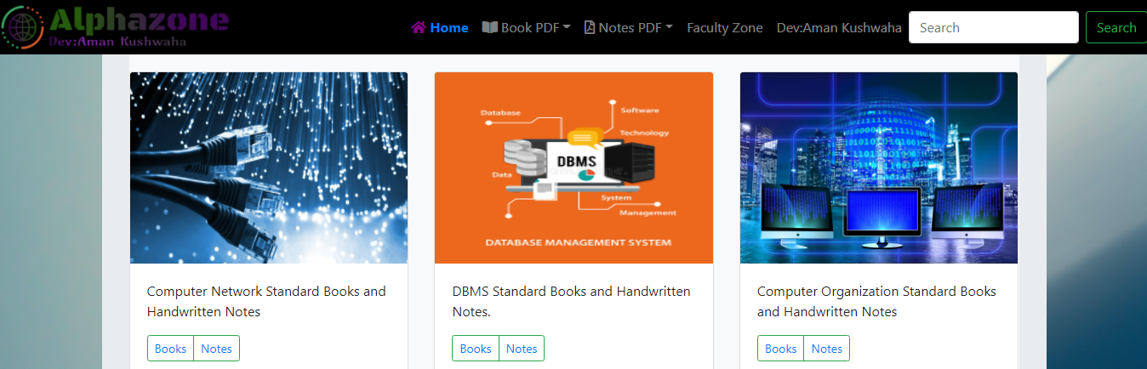
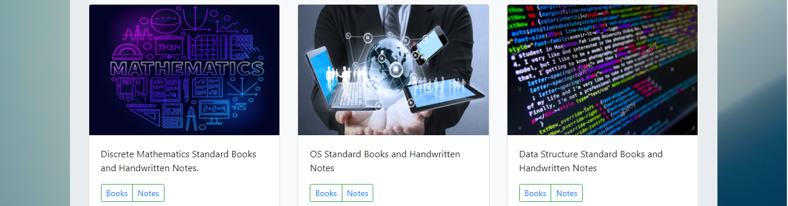
Section Divider
Student zone for Standard Books and Handwritten Notes

Slide 10
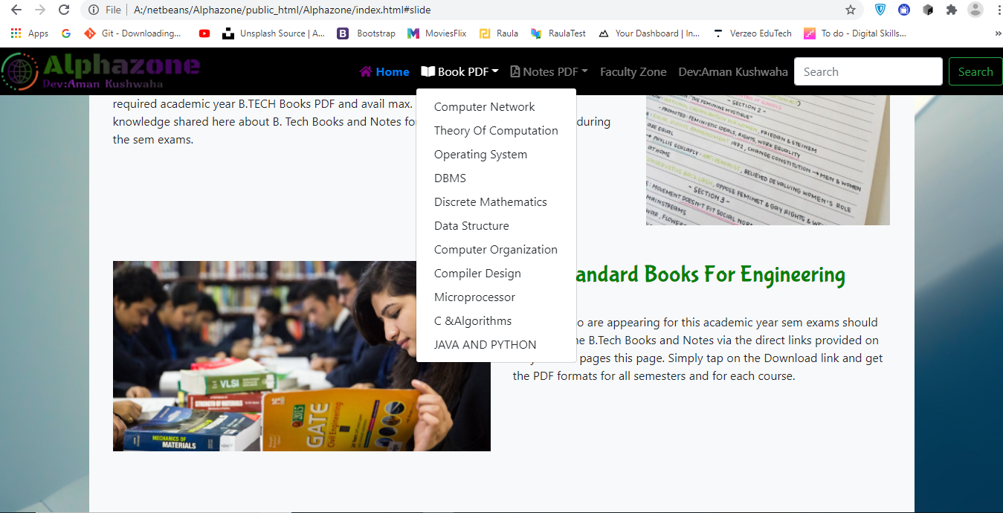
Section Divider
Books zone

Slide 11
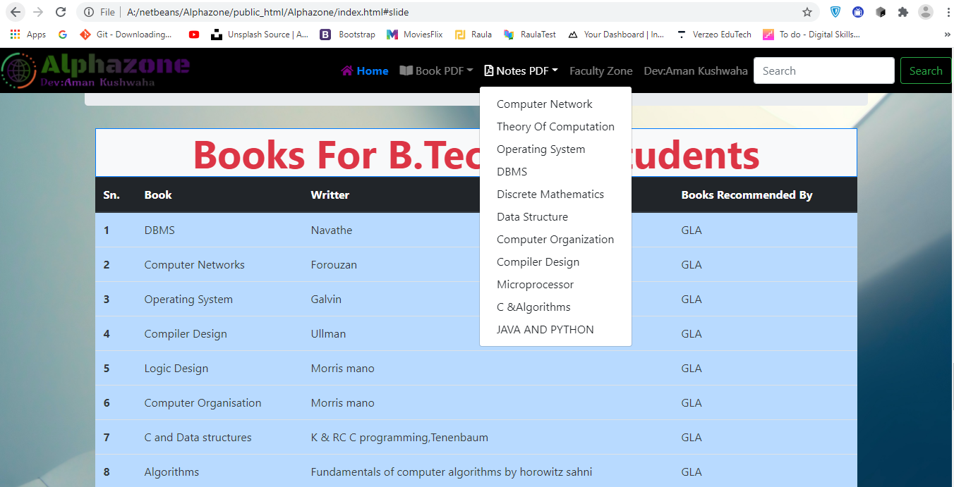
Notes zone

Slide 12
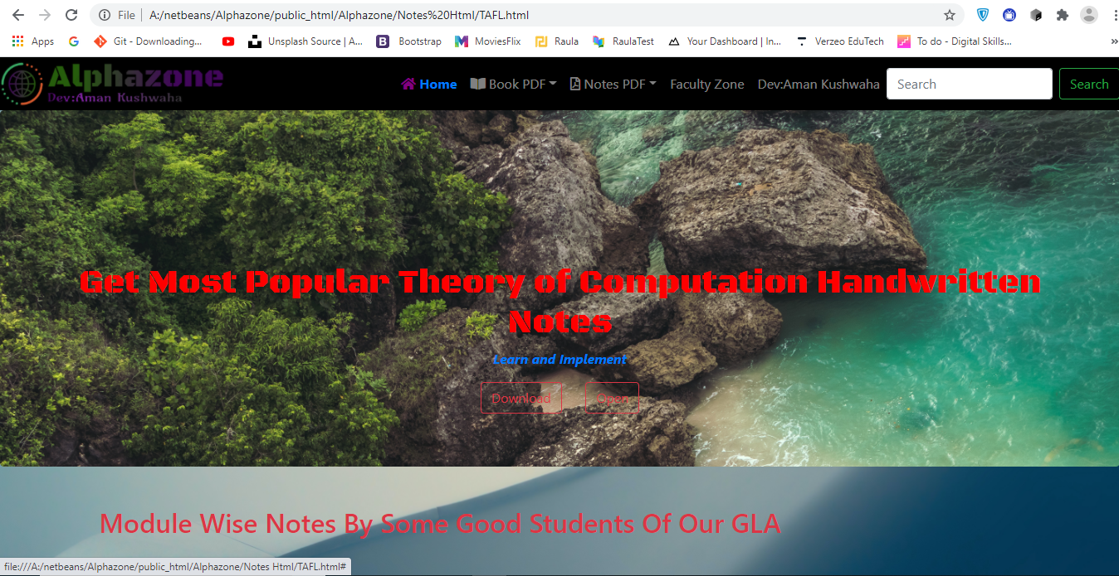
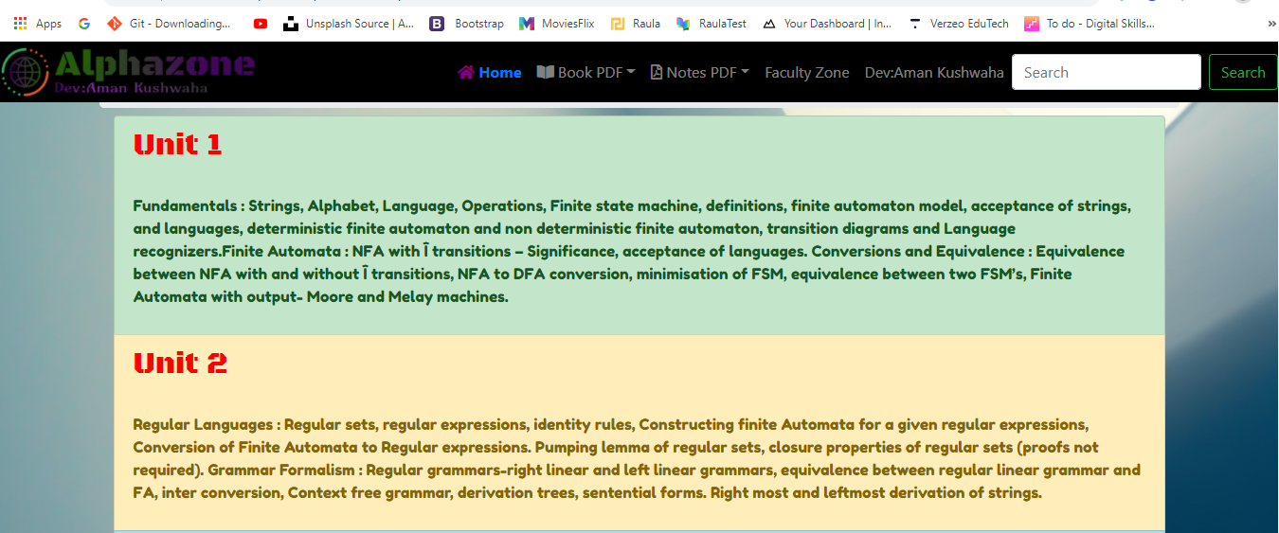
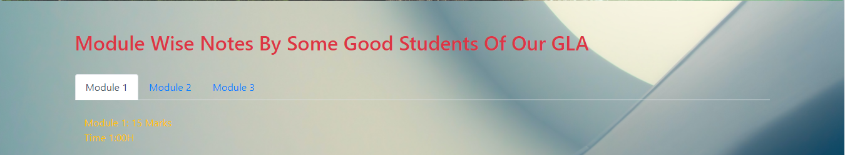
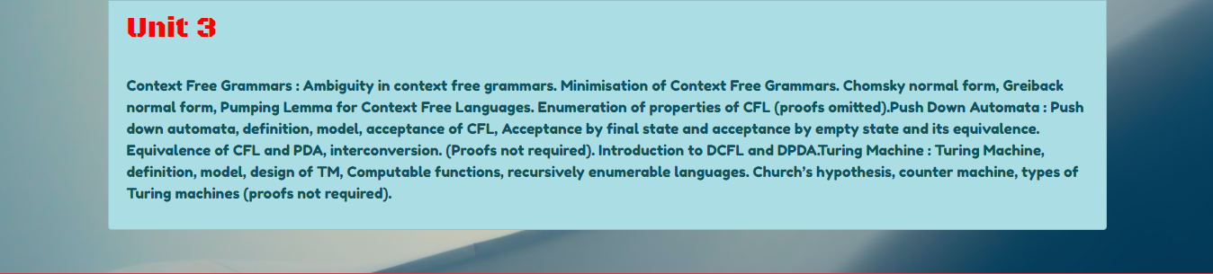
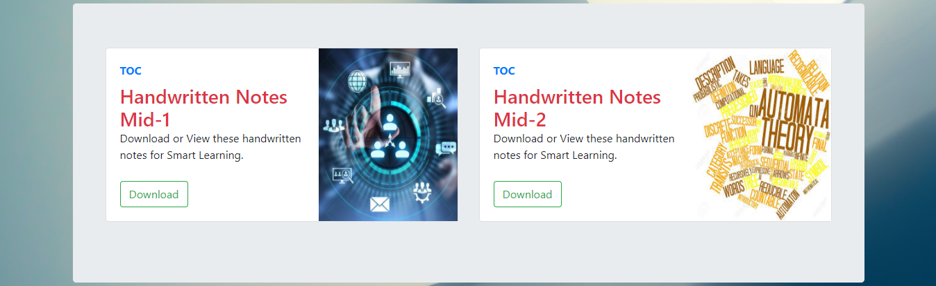
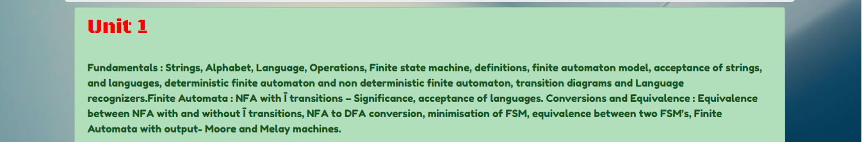
Handwritten notes written By GLA Students for all subjects

Slide 13
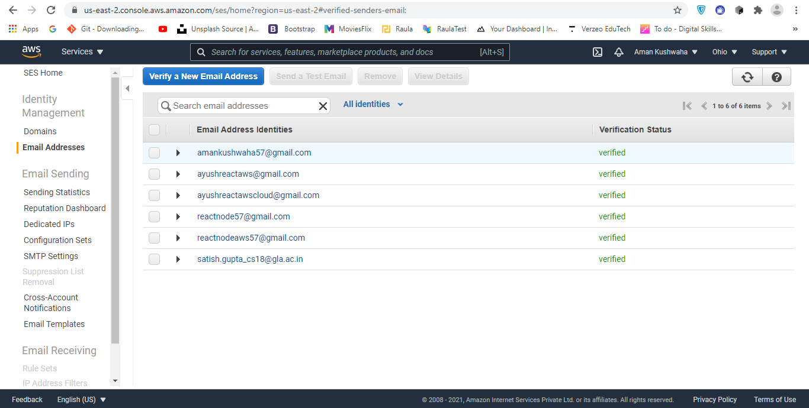
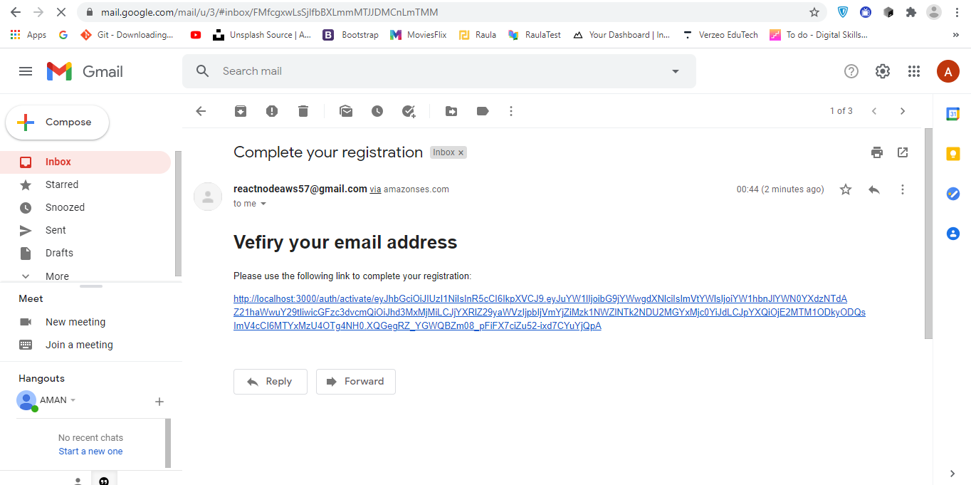
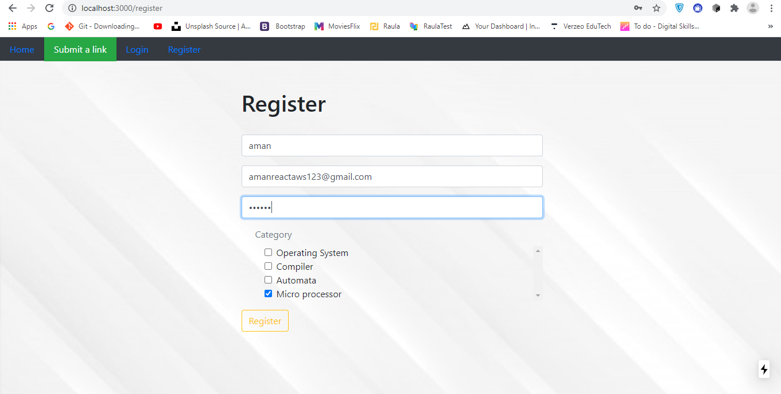
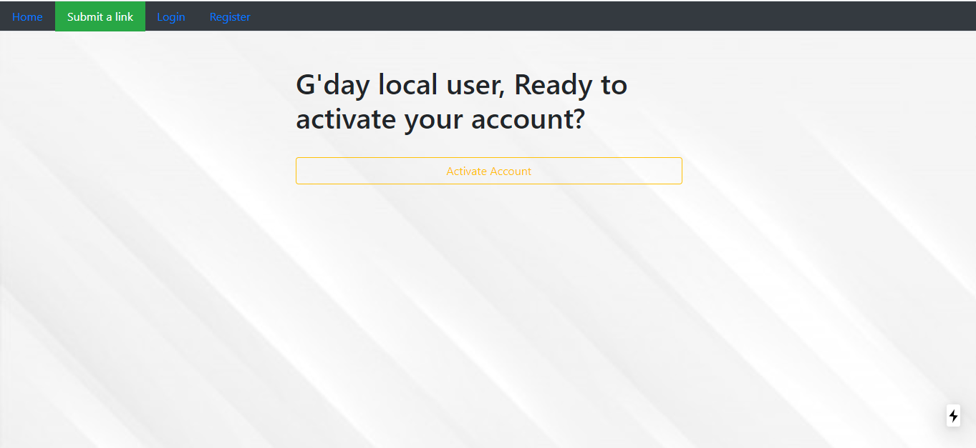
Step 1: Mail Varification
Step 3: Varification
Step 4: Account Activation
Step 2: New User Registration
Sign Up For New User

Slide 14
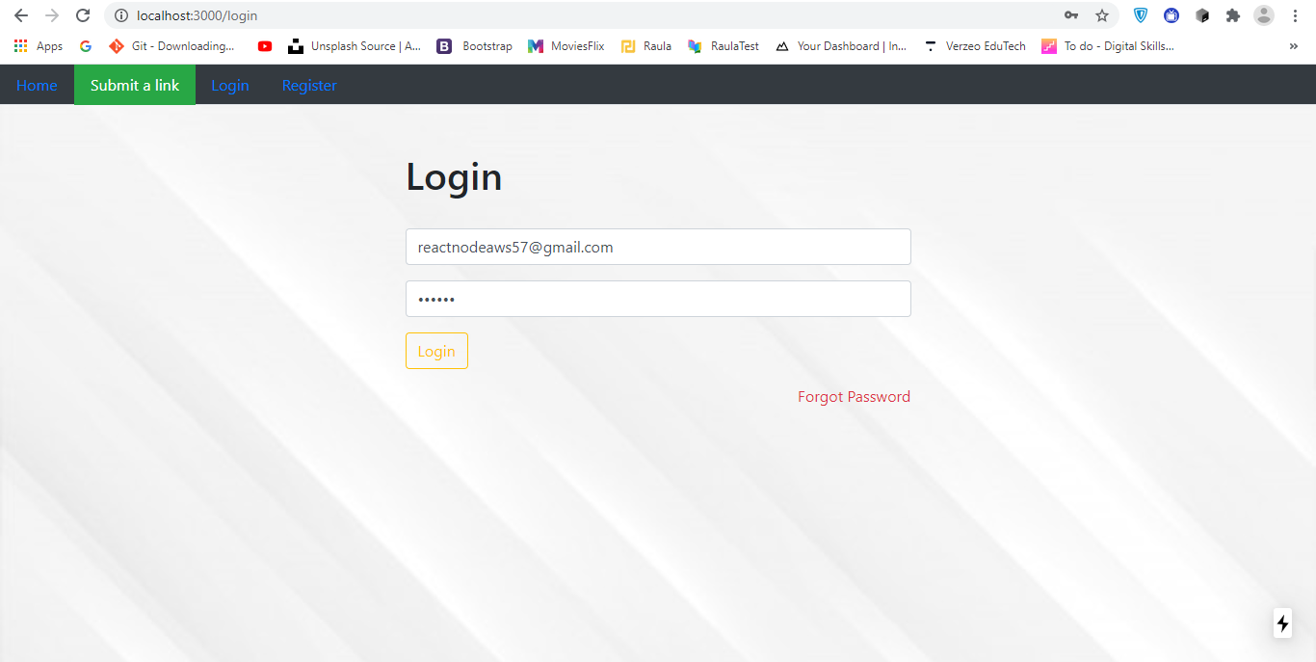
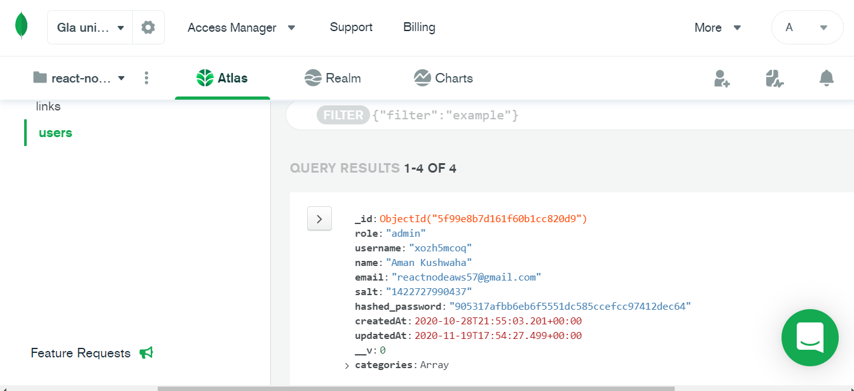
Credential should be match
From mongoo Data Base
User Log In

Slide 15
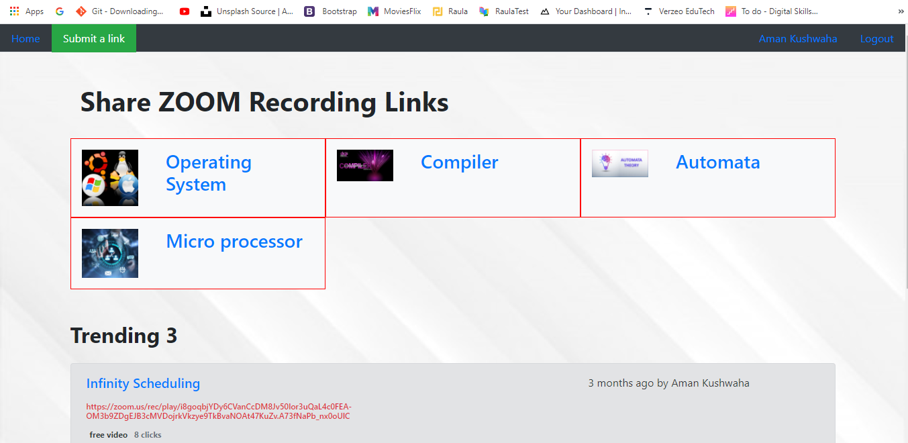
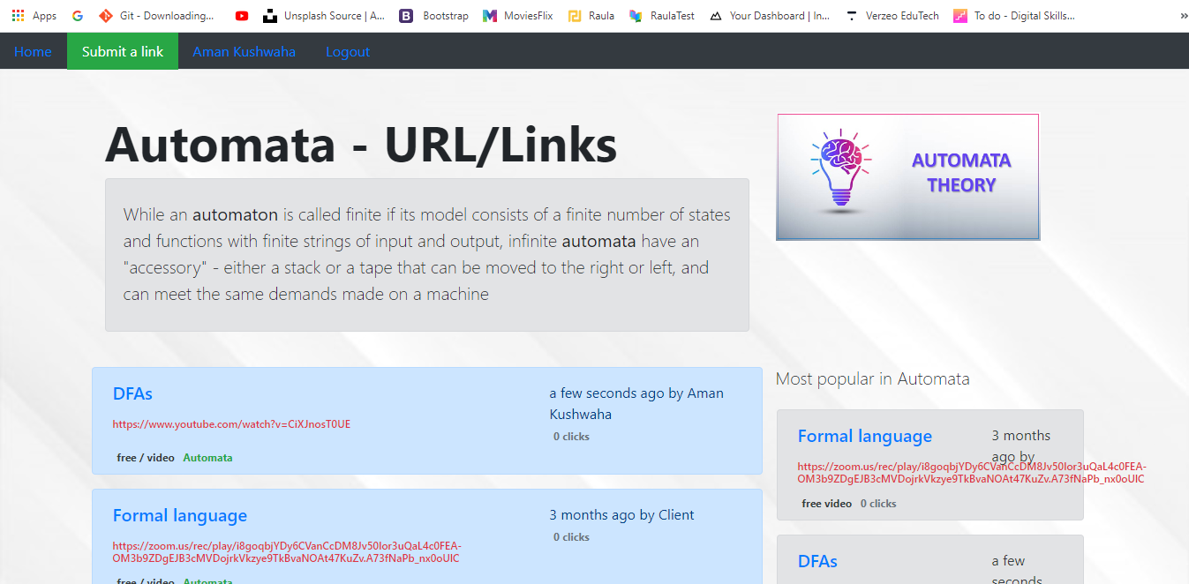
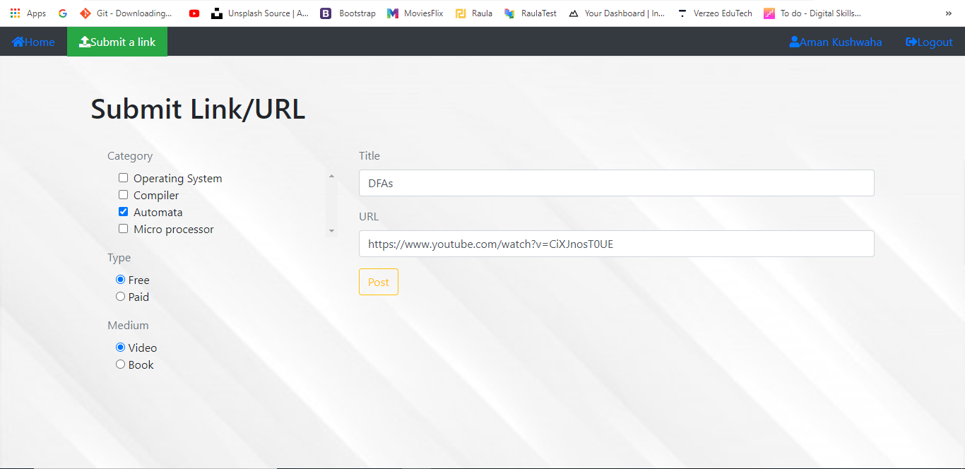
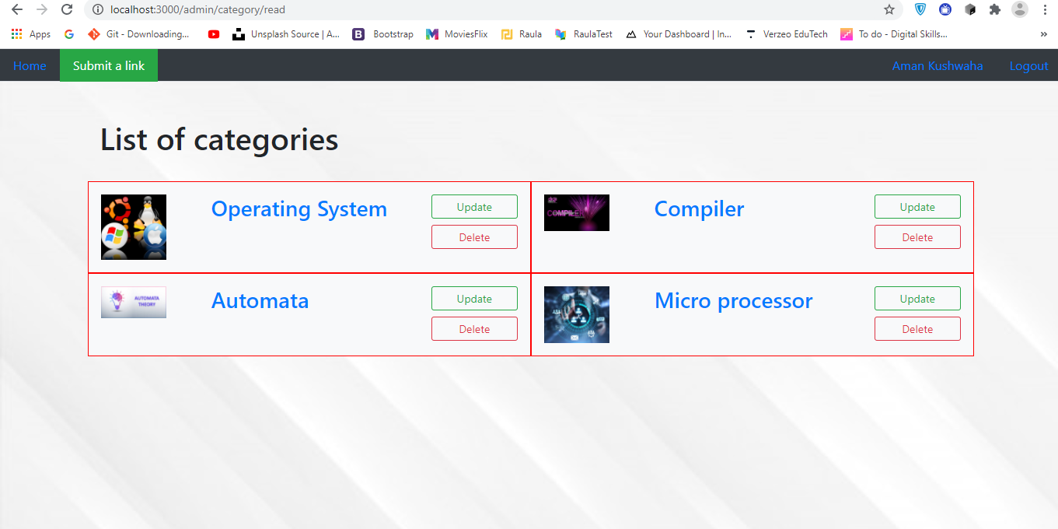
Step 1: Choose Subject
Step 3: Link Created
Step 2: Fill URL Details
Step 4: Delete /Update Category
Zoom Recording Sharing Facility( For Teachers)

Slide 16
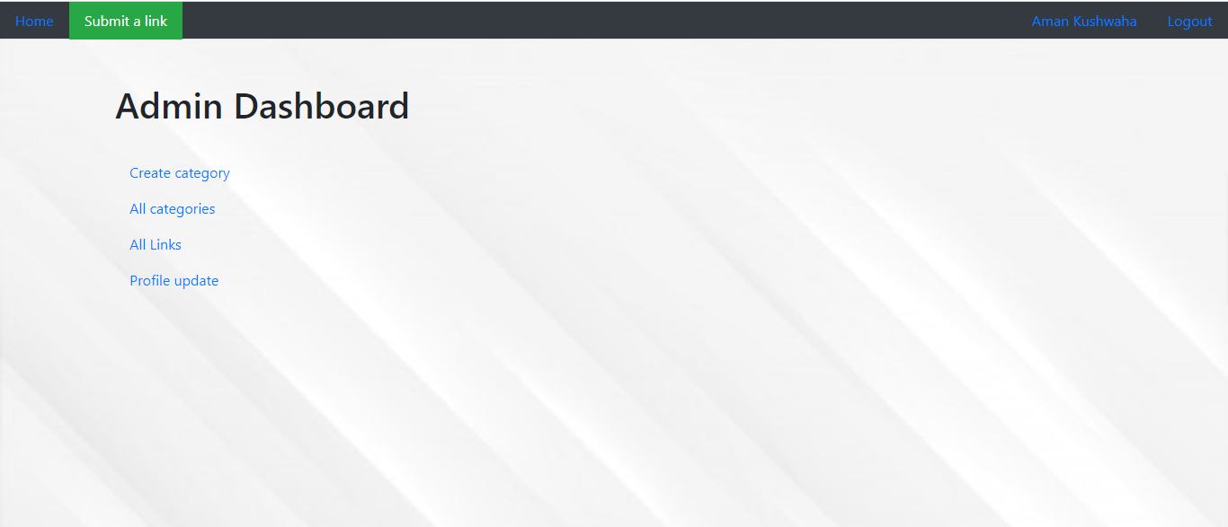
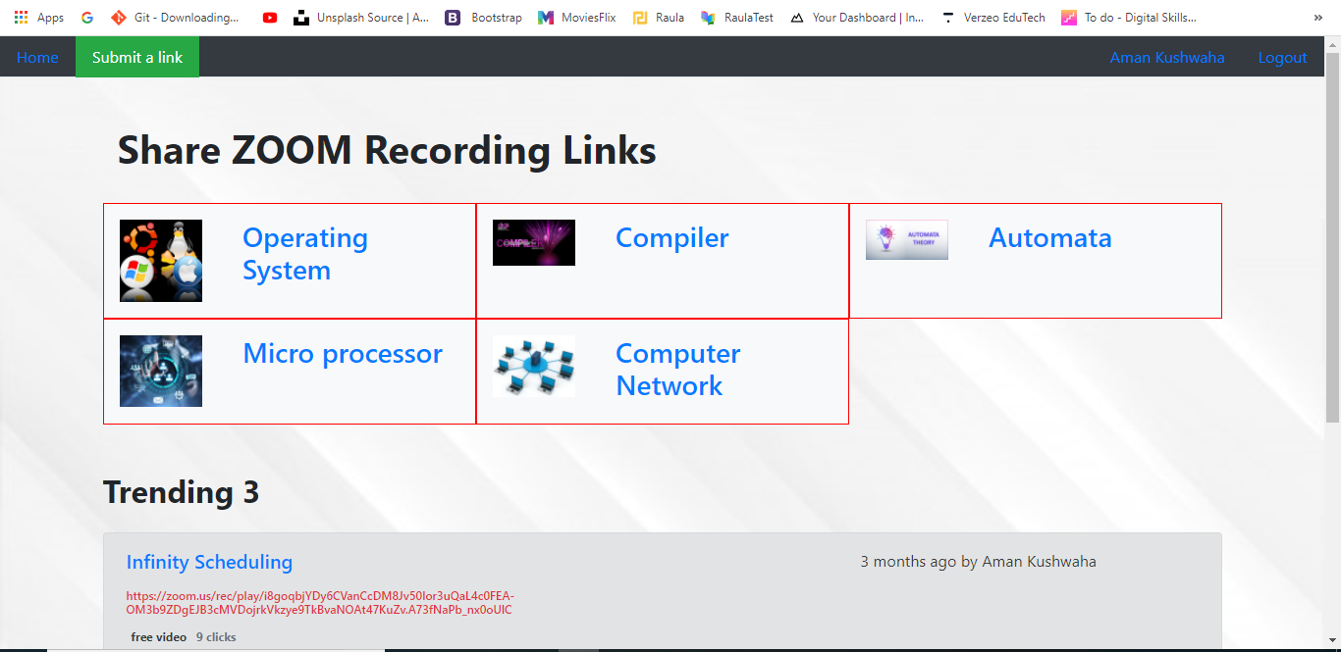
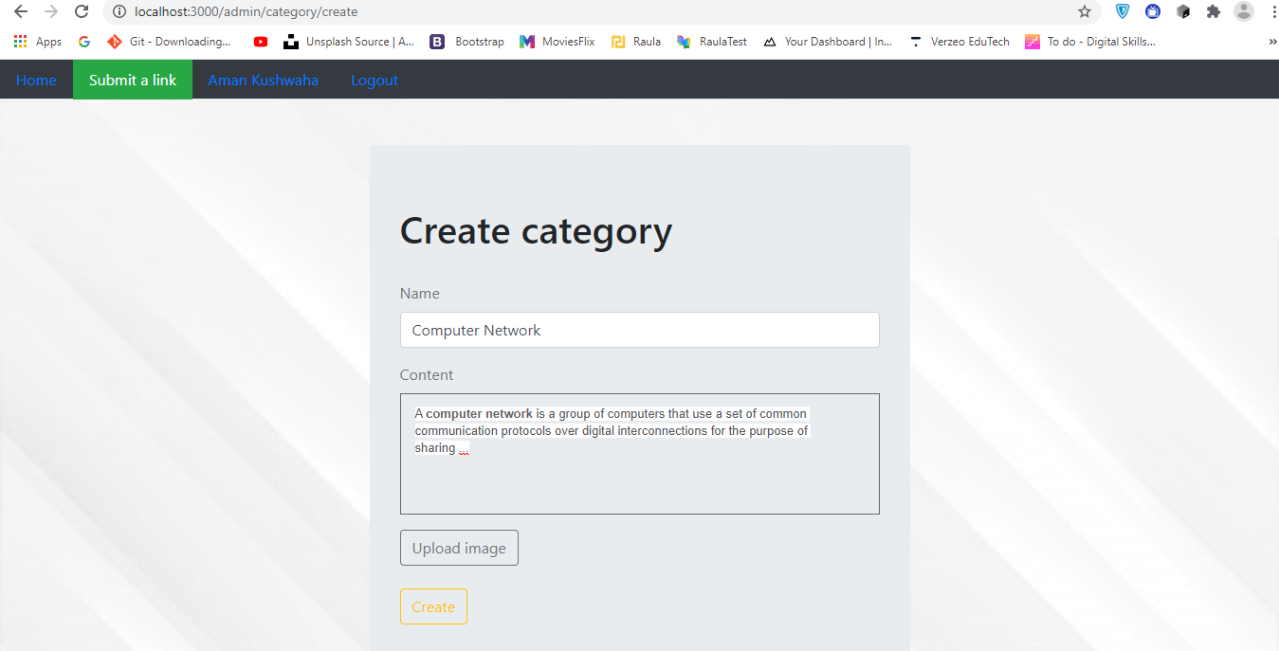
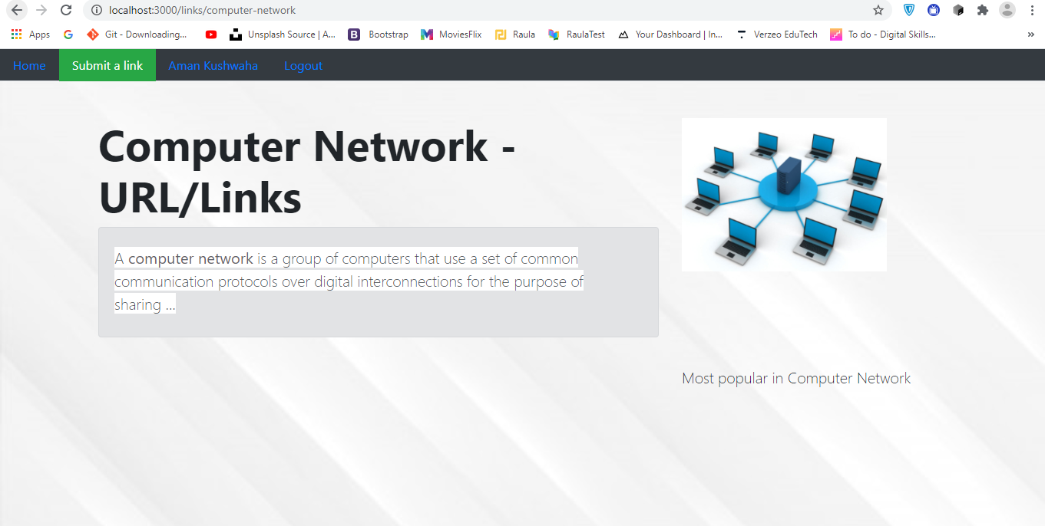
Admin Have 4 Permission to access the portal
Category Created
Create Category of Subjects
Zero Links in this New Category
Admin Access – A(Create Category)

Slide 17
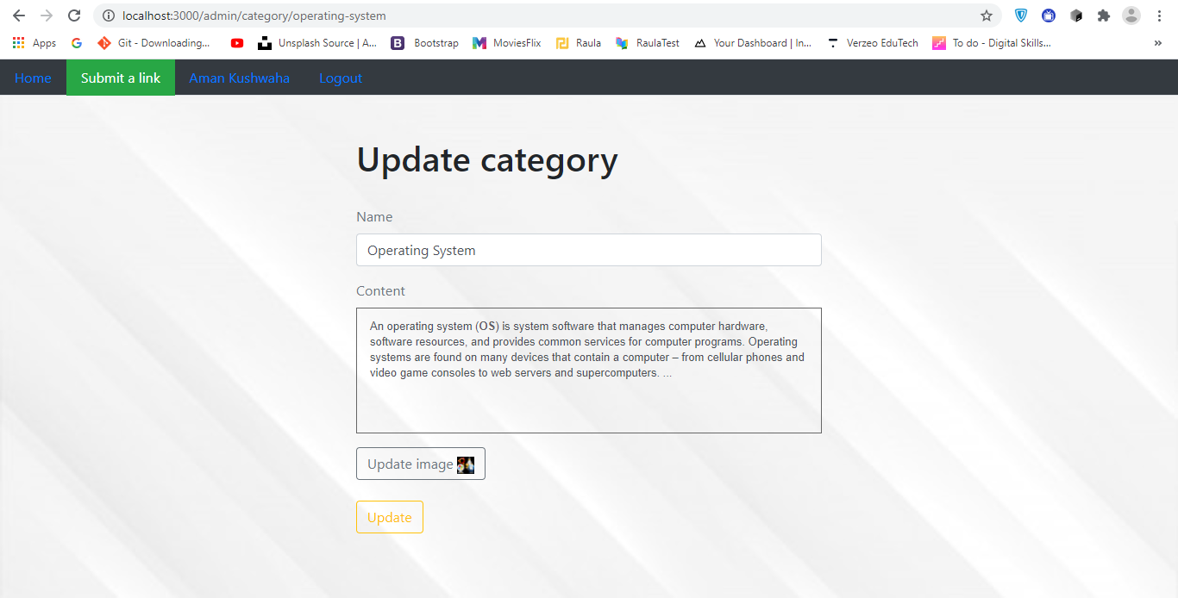
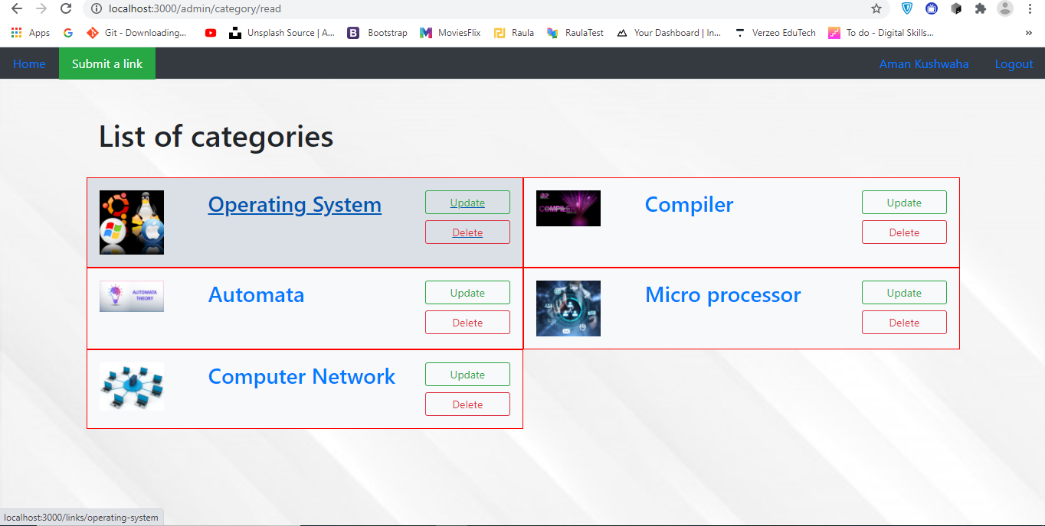
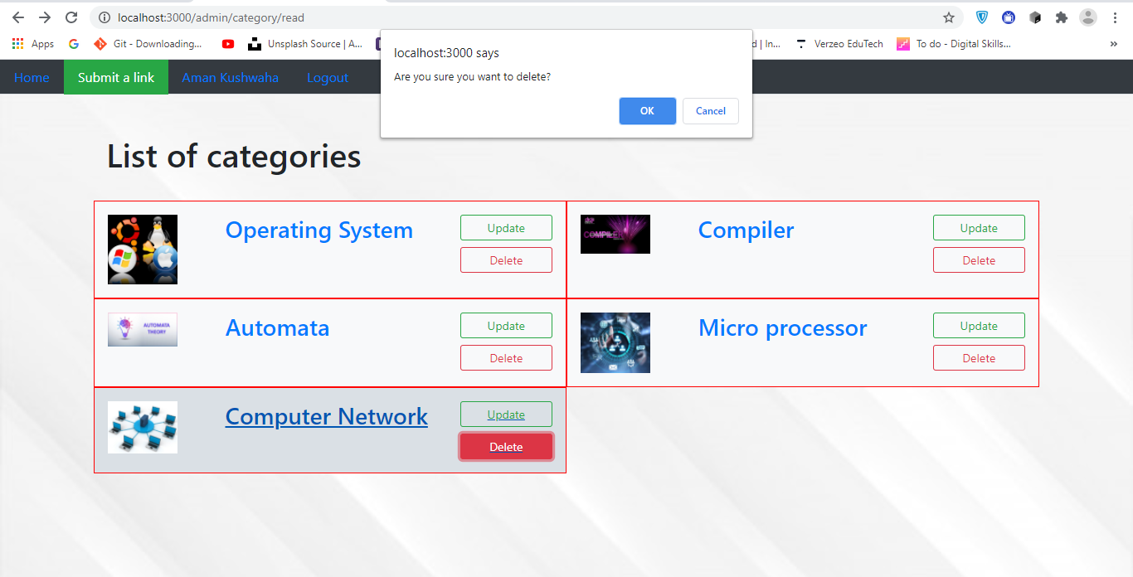
Admin Have 4 Permission to access the portal
Update Category
Update or delete Categories
Delete Category
Admin Access – B(Delete or Update Category)

Slide 18
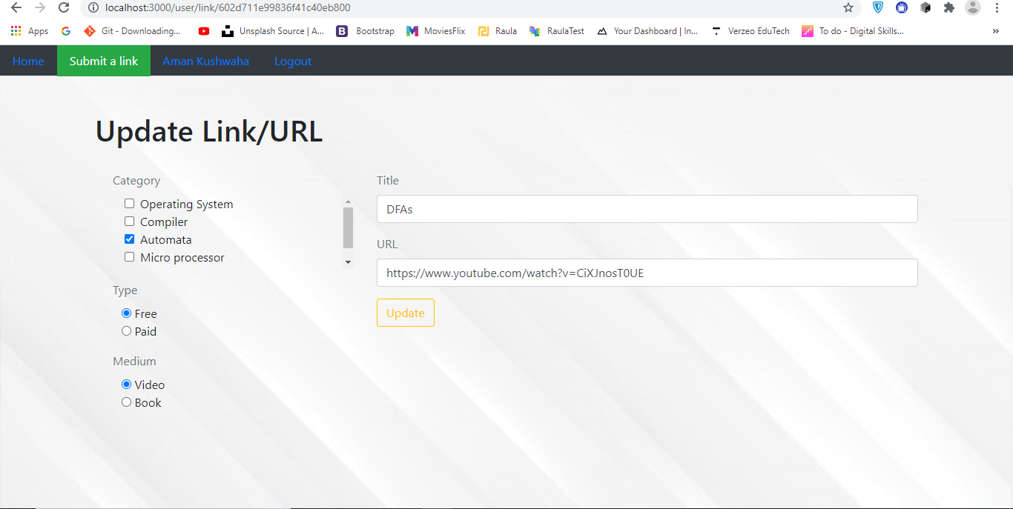
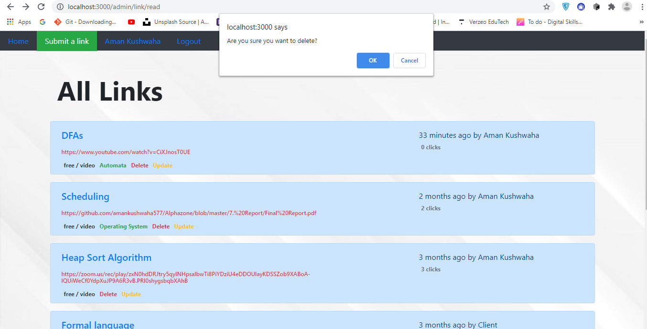
Admin Have 4 Permission to access the portal
Update Links
Add Link
Delete Links
Admin Access – C(Add, Delete or Update Links)

Slide 19


Thank You
Alphazone
Aman Kushwaha

Slide 20
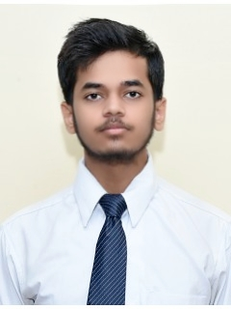

Developer:
Linkedin
https://www.linkedin.com/in/aman-kushwaha-ba0038182/
Twitter
https://twitter.com/amankushwaha57
CEO
Aman Kushwaha
B.Tech Computer Science
181500075
Sec : D

